Slide 1


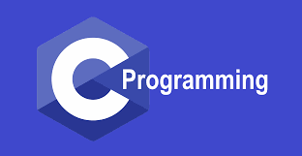
Chapter: 5
C Programs with Mustafa Rahman
Web & Software Developer
C360Soft.Ai, India. (Remote Job)
ICT Lecturer of MIFM

Slide 2


Functions
block of code that performs particular task
Take
Argument
Do
Work
Return
Result
it can be used multiple times
increase code reusability

Slide 3

Syntax
1
Function Prototype
void printHello( );
> Tell the compiler

Slide 4







Syntax
2
Function Definition
void printHello() {
printf("Hello");
}
> Do the Work

Slide 5

Syntax
3
Function Call
int main() {
printHello( );
return 0;
}
> Use the Work

Slide 6
Properties
- Execution always starts from main
- A function gets called directly or indirectly from main
- There can be multiple functions in a program

Slide 7
Function Types
Library
function
User-
defined
Special functions
inbuilt in C
declared & defined by
programmer
scanf( ), printf( )

Slide 8
Passing Arguments
functions can take value & give some value
parameter return value

Slide 9
Passing Arguments
void printHello( );
void printTable(int n);
int sum(int a, int b);

Slide 10
Passing Arguments
functions can take value & give some value
parameter return value

Slide 11
Argument v/s Parameter
values that are
passed in
values in function
declaration &
definition
function call
used to send
value
used to receive
value
actual
parameter
formal
parameters

Slide 12
NOTE
a. Function can only return one value at a time
b. Changes to parameters in function don't change the values in
calling function.
Because a copy of argument is passed to the function

Slide 13
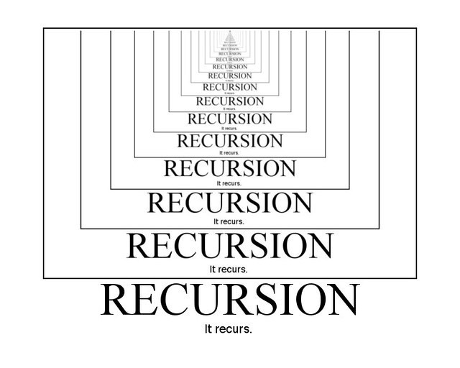
Recursion
When a function calls itself, it's called recursion

Slide 14
Properties of Recursion
a. Anything that can be done with Iteration, can be done with
recursion and vice-versa.
b. Recursion can sometimes give the most simple solution.
c. Base Case is the condition which stops recursion.
d. Iteration has infinite loop & Recursion has stack overflow

